Slide 1
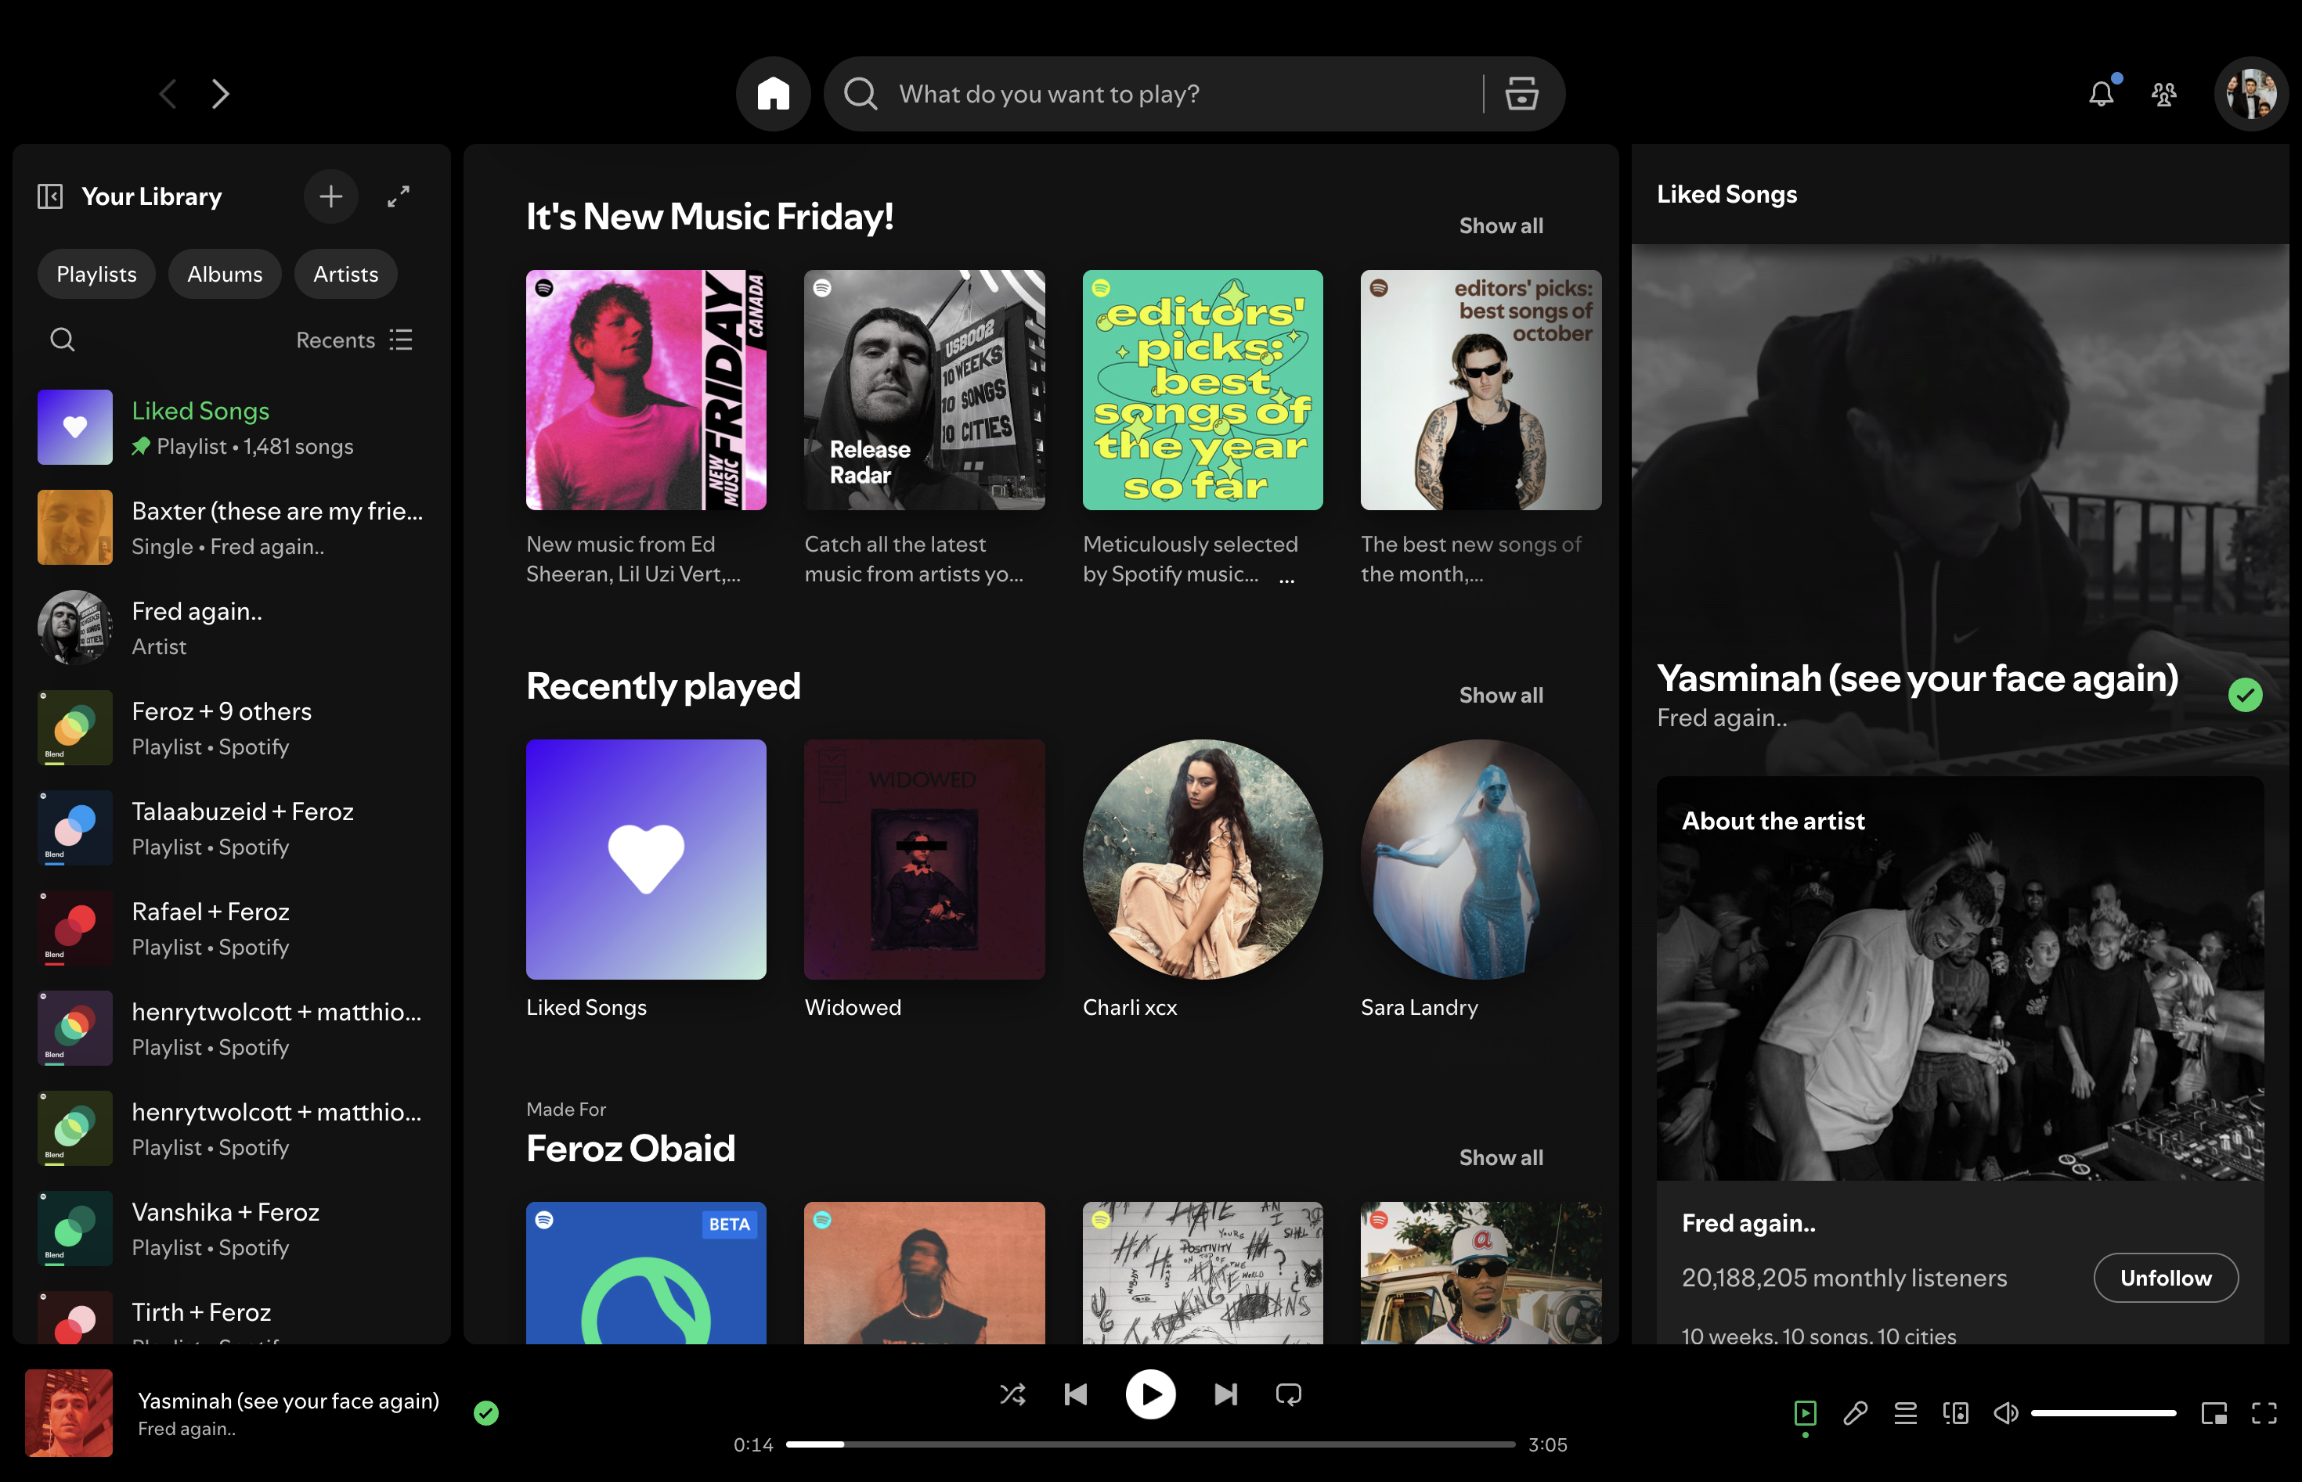
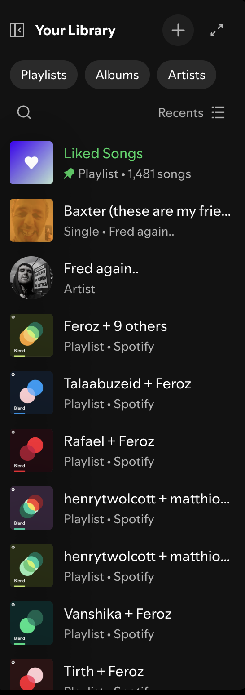

Personalized Spotify Mood Based Playlist Generation

Slide 2
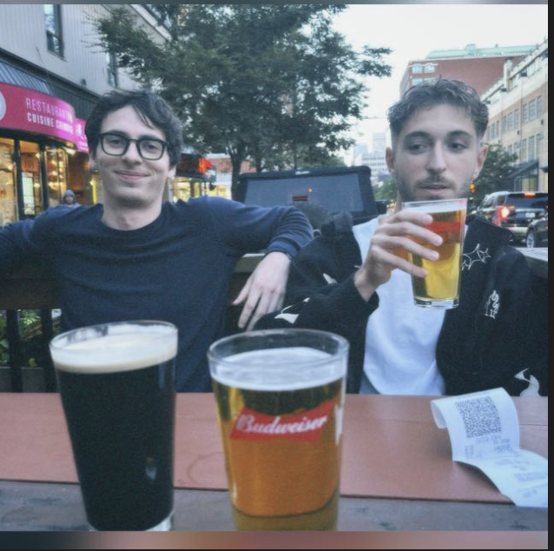


Matthieu
Problem Statement
Our Vision
Dataset Exploration
Problem Statement
Data Cleaning
Feature Engineering
Music streaming platforms recommend content primarily using past listening behavior, genre preferences, or trending patterns.
While effective, these methods fail to consider a user’s current emotional state, which plays a critical role in music preference.
This leads to user frustration and time spent manually filtering playlists.Our goal is to develop a system that detects mood and automatically generates a personalized playlist aligned with that emotional context.
Model Selection
Hyperparameter Tuning
Results & Cluster Naming
Operational Architecture
Results & Analysis
Play
Follow
Future Exploration

Slide 3


Matthieu
Problem Statement
Our Vision
Our Vision
Dataset Exploration
Data Cleaning
Feature Engineering
Our vision is to create a personalized music experience that adapts to how users feel in the moment. Instead of scrolling, searching, or debating what to play, users can simply select their mood; and the platform will generate a playlist that matches their emotional state.
Model Selection
Hyperparameter Tuning
Personalized + Discovery – Based Playlist
Transforming Listening Into an Emotional Experience
Results & Cluster Naming
Operational Architecture
This playlist is tailored using a combination of the user’s existing music library and new songs recommended through machine-learning-powered discovery. The result is a listening experience that feels familiar yet exciting, balancing comfort with exploration.
By blending personalization, emotional context, and music discovery, we aim to transform passive listening into a deeply intuitive and meaningful experience.
Results & Analysis
Future Exploration

Slide 4
Matthieu
Problem Statement
Dataset Exploration
Our Vision
Dataset Exploration
Data Cleaning
Feature Engineering
Model Selection
01
Dataset : Kaggle Sporify Tracks 2022
Hyperparameter Tuning
02
Columns : track_name, song_name, musical features (Acousticness, tempo, mode,...)
Results & Cluster Naming
Operational Architecture
Assumptions
Musical Features alone are enough to capture musical taste
Music can be separated into clear mood categories based on musical features
The genre and music type distribution of the dataset is representative of a true streaming catalogue
The first artist featured in the composite artists column is the main contributer
We assumed that songs with the same title and main contributing artist were duplicates
03
Results & Analysis
Future Exploration

Slide 5

Matthieu
Problem Statement
Our Vision
Dataset Exploration
Data Cleaning
Global Songs Dataset
Data Cleaning
Feature Engineering
Model Selection
#
Title
What was done?
Findings/Issues
Actions/Outcomes
1
Data Inspection
Reviewed data types, structure, and summary statistics
Understood feature distributions and metadata
No corrections needed at this stage
Hyperparameter Tuning
2
Missing Values
Checked for null entries
3 missing values (artists, album_name, track_name)
Filled using mode: "The Beatles", "Alternative Christmas 2022", "Run Rudolph Run" → 0 missing values
Results & Cluster Naming
3
Duplicate Rows
Searched for repeated based on track_name and artist
32k duplicates found
Drop.duplicate
Operational Architecture
Results & Analysis
4
Text Standardization
Clean and formatted Text based field
114 unique genres, inconsistent text formatting
Lowercased all text, trimmed whitespace, standardized metadata text
Future Exploration
5
Data Integrity Validation
Valid Ranges and Feature Constraints
Duration ≤ 0: 1 row; tempo ≤ 0: 157 rows; loudness > 0 indicates clipping; time_signature outliers: 163 rows
Marked for removal or correction in next step

Slide 6
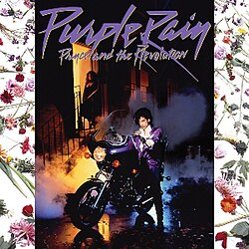
Matthieu
Problem Statement
Our Vision
Dataset Exploration
Data Cleaning
User Songs Dataset
Data Cleaning
Feature Engineering
Model Selection
#
Title
What was done?
Findings/Issues
Actions/Outcomes
1
Data Inspection
Columns Identification
Understood feature distributions and metadata
.lower & .strip on categorical columns
Hyperparameter Tuning
Results & Cluster Naming
2
Missing Values
Checked for null entries
0 missing values
None
3
Duplicate Rows
Searched for repeated based on track_name and artist
700 duplicates found
Drop.duplicate
Operational Architecture
4
Merge User and Spotify Data
Merge on track and artist names
None
Personal_df.csv
Results & Analysis
Future Exploration

Slide 7
Matthieu
Problem Statement
Our Vision
Dataset Exploration
Feature Engineering
Data Cleaning
Feature Engineering
The Spotify data set was already mainly prepared for modelling so little feature engineering was necessary.
Model Selection
01
Min max scale tempo
03
‘Artists’ column composite values split by ‘;’ into new
columns
Hyperparameter Tuning
Results & Cluster Naming
Operational Architecture
02
Loudness inverted min-max scaling
04
‘explicit’ binary conversion
Results & Analysis
Future Exploration

Slide 8
Matthieu
Problem Statement
Model Selection
Our Vision
Dataset Exploration
Data Cleaning
K-means, Hierarchical or DB-Scan?
Fast & Scalable
Accurate Geometry Fit
Feature Engineering
Goal 01
Goal 02
Why K-means?
Model Selection
Only algorithm that can predict new song clusters instantly
Centroids enable your cosine similarity recommendation logic
Spherical clusters match your audio feature geometry
Supports two-level clustering (main + subclusters) efficiently
600x faster than hierarchical (Good for larger datasets and scalable)
Production-ready for real-time ingestion and recommendations
Hyperparameter Tuning
Results & Cluster Naming
Structured and Flexible
Production Ready
Goal 03
Goal 04
Operational Architecture
Results & Analysis
Future Exploration

Slide 9
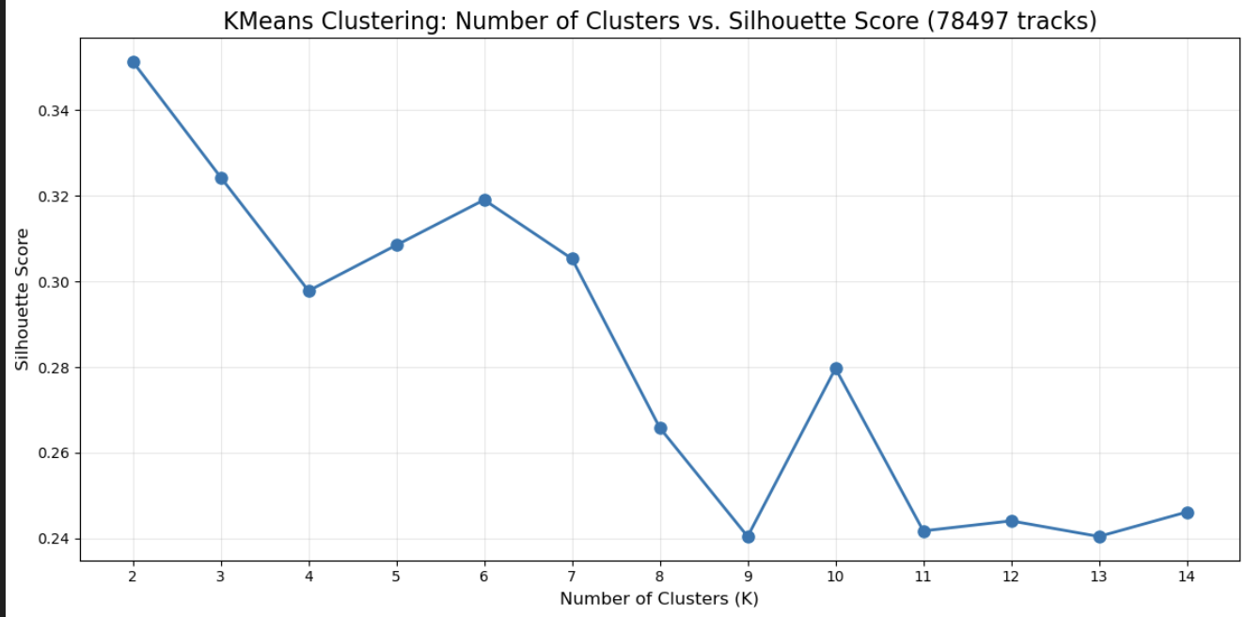
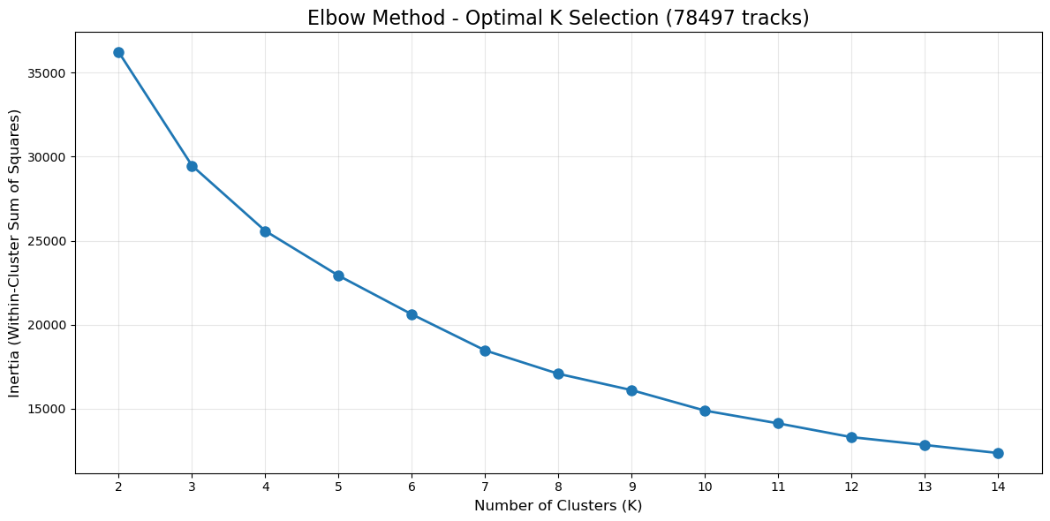
Matthieu
Problem Statement
Hyperparameter Tuning
Our Vision
Dataset Exploration
Data Cleaning
Feature Engineering
Silhouette Score
Model Selection
Hyperparameter Tuning
Optimal k=6
Results & Cluster Naming
Operational Architecture
Results & Analysis
Future Exploration
Elbow Curve

Slide 10
Matthieu
Result & Cluster Naming
Problem Statement
Our Vision
Labelled our clusters based on average features values in each clusters
Warm / Feel-Good
Medium=high energy
Good danceability
Moderately positive valence
Moderate acousticness (warmth)
22,103 tracks
Dataset Exploration
Data Cleaning
Moody Energetic
Medium–high energy
Moderate danceability
Low valence (emotionally darker)
Low acousticness ( tense / not warm)
5,223 tracks
Happy / Energetic
Highest energy of all clusters
High danceability
Highest valence (cheerful / bright)
Low acousticness (lively)
25,335 tracks
Feature Engineering
Intense / Driven
High energy
Low valence (serious, not cheerful)
Low acousticness (sharper / aggressive tone)
Very high instrumentalness (focused)
5,734 tracks
Model Selection
Hyperparameter Tuning
Results & Cluster Naming
Sad / Reflective
Low energy
High acousticness (soft, intimate)
Lower valence (emotional and wistful)
Slightly higher speechiness ( expressive)
14,896 tracks
Operational Architecture
Melancholy / Peaceful Sad
Lowest energy
Highest acousticness
Lowest valence (emotional heaviness)
High instrumentalness (quiet, drifting)
5,206 tracks
Results & Analysis
Future Exploration

Slide 11
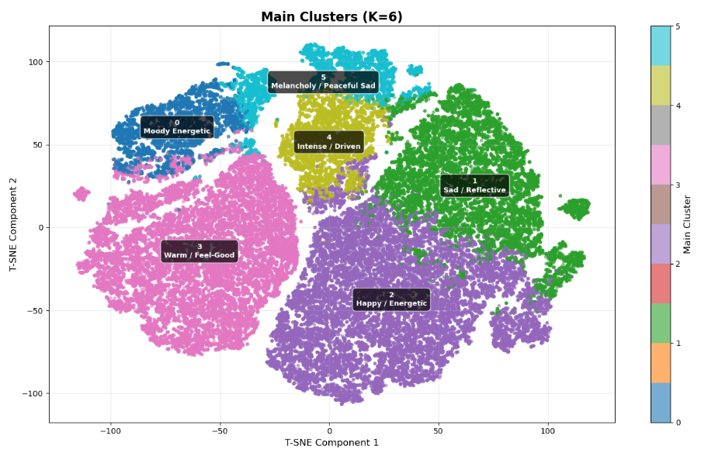
Matthieu
T-SNE Visualization
Problem Statement
Our Vision
Dataset Exploration
Data Cleaning
Feature Engineering
Model Selection
Hyperparameter Tuning
Results & Cluster Naming
Operational Architecture
Results & Analysis
Future Exploration

Slide 12
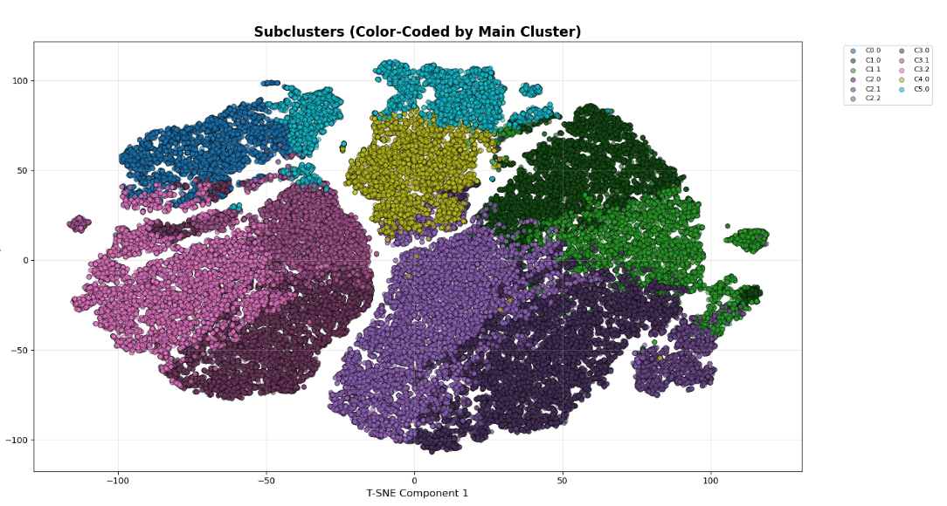
Matthieu
Sub-clustering
Problem Statement
Our Vision
Dataset Exploration
Data Cleaning
Feature Engineering
Model Selection
Hyperparameter Tuning
Results & Cluster Naming
Final Architecture
Main K-Means (K=6): Broad mood categories
Size-based logic: Determine subclusters per cluster
<10K: No split
10K-20K: 2 subclusters
20K: 3 subclusters
Independent K-Means per clustering
Result: 12 total micro-moods with 2K-12K songs each
Use case: Proportional recommendations matching user's specific subcluster preferences
Results & Analysis
Future Exploration

Slide 13
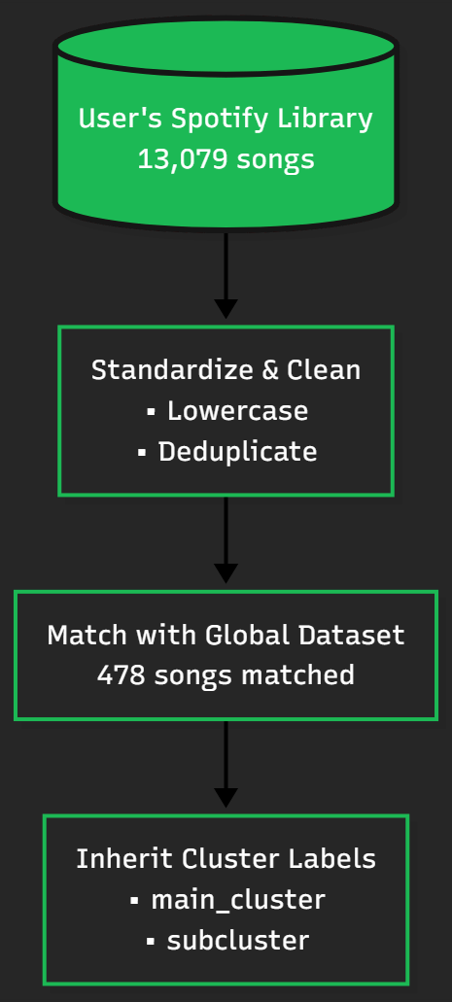
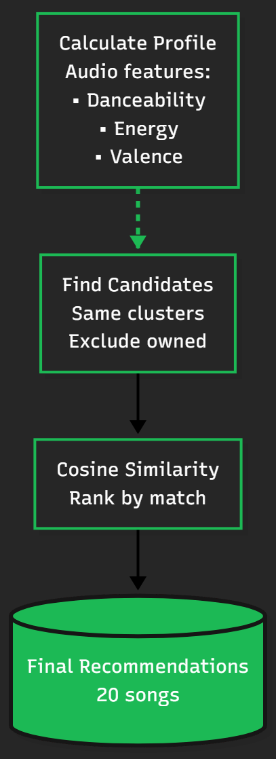
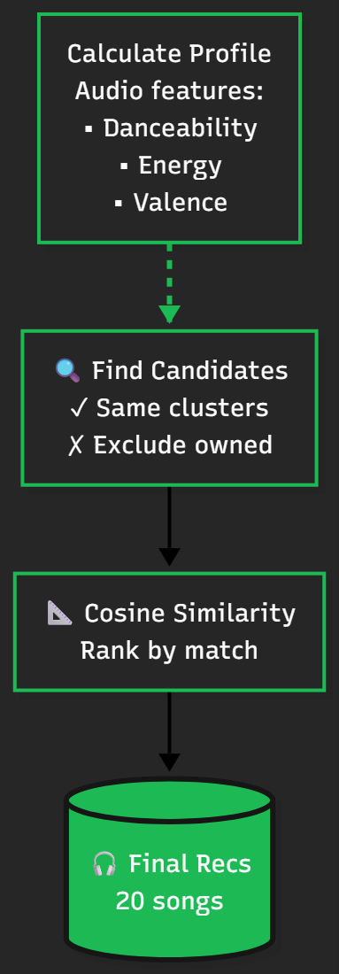
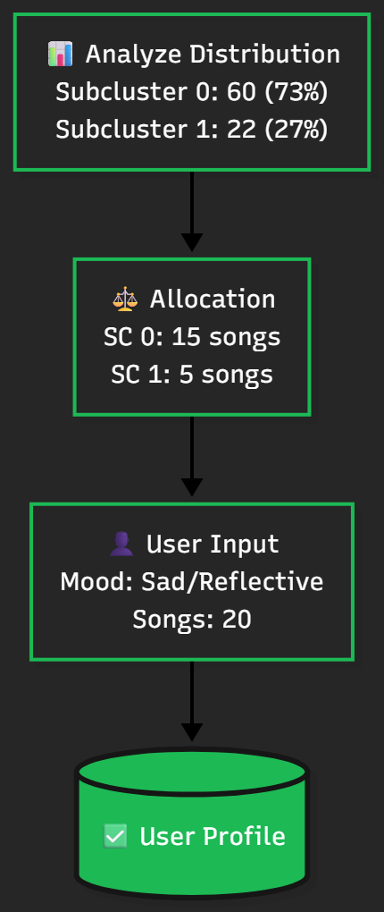
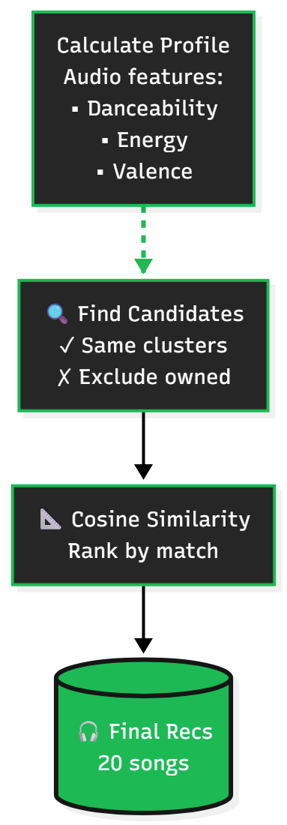
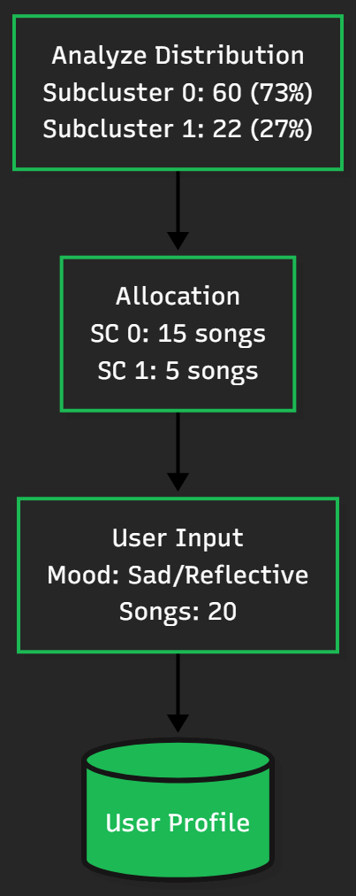
Matthieu
Operational Architecture
Problem Statement
Our Vision
Dataset Exploration
Data Cleaning
Feature Engineering
Model Selection
Hyperparameter Tuning
Results & Cluster Naming
Operational Architecture
Results & Analysis
Future Exploration

Slide 14
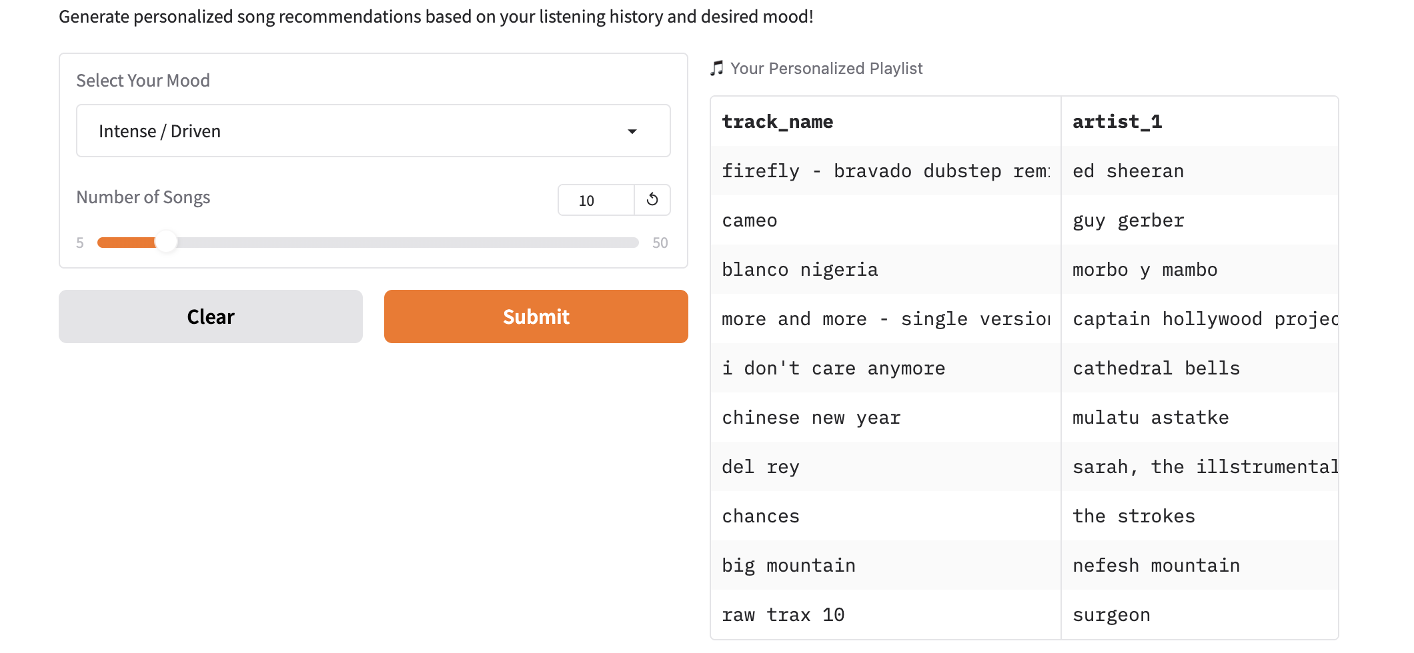
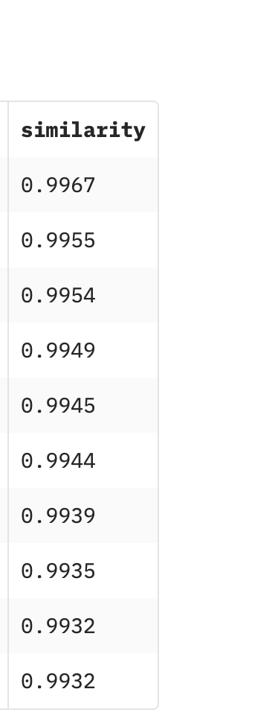
Matthieu
Results & Analysis
Problem Statement
Our Vision
Dataset Exploration
Data Cleaning
Feature Engineering
Model Selection
Hyperparameter Tuning
Results & Cluster Naming
Operational Architecture
1. Mood was captured very effectively but personalising according to taste was much more difficult.
Results & Analysis
2. Two songs can appear very similar from a musical feature perspective, but when recommended to a listener can yield very different results.
Future Exploration

Slide 15

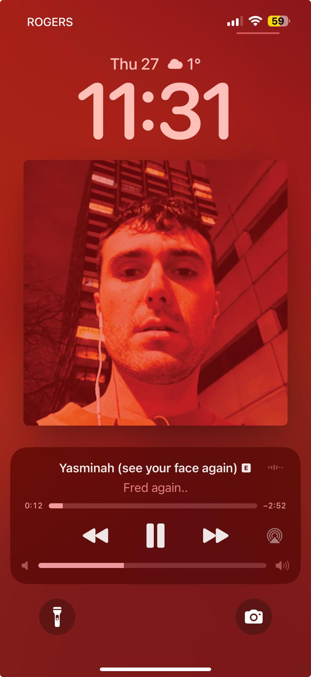

Matthieu
Problem Statement
Future Exploration
Our Vision
Dataset Exploration
Data Cleaning
How can we incorporate taste more effectively?
Feature Engineering
Model Selection
Hyperparameter Tuning
How can we ensure scalability?
Results & Cluster Naming
Final Architecture
Results & Analysis
Future Exploration

Slide 16



Thank You!
Yasminah (see your face again)
Fred Again
0:23
-3:25

Slide 17


Slide 18


HAPPY Early B DAY TALA !!!!

